Slide 1
BİL142 Bilgisayar Programlama-II

Slide 2
Programming
A program is a set of instructions in proper sequence, that causes a computer to perform a particular task.
When learning to program in any programming language, it’s best just to learn the “rules of the game.”
Modern programs are projects composed of many of individual program modules that have to be linked together in order to be run. In fact most developer systems have their own integrated development environment (ide) and programs are developed in phases within the ide.

Slide 3
Why Use C++?
1. Conciseness: programming languages allow us to express common sequences of commands more concisely. C++ provides some especially powerful shorthands.
2. Maintainability: modifying code is easier when it entails just a few text edits, instead of rearranging hundreds of processor instructions. C++ is object oriented (more on that later), which further improves maintainability.
3. Portability: different processors make different instructions available. Programs written as text can be translated into instructions for many different processors; one of C++’s strengths is that it can be used to write programs for nearly any processor.

Slide 4
…also
C++ is a high-level language: when you write a program in it, the shorthands are sufficiently expressive that you don’t need to worry about the details of processor instructions. C++ does give access to some lower-level functionality than other languages (e.g. memory addresses).

Slide 5
Application Areas
banking and financial (funds transfer, financial modelling, teller machines)
classical systems programming (compilers, operating systems, device
drivers, network layers, editors, database systems)
small business applications (inventory systems)
desktop publishing (document viewers/editors, image editing)
embedded systems (cameras, cell phones, airplanes, medical systems,
appliances)
entertainment (games)
GUI
hardware design and verification
scientific and numeric computation (physics, engineering, simulations,
data analysis, geometry processing)
servers (web servers, billing systems)
telecommunication systems (phones, networking, monitoring, billing,
operations systems)

Slide 6
C++ Program Phases
…in the C++ programming environment
Edit – in the text editor. Save with .cpp extension
Preprocess - e.g., text replacement, including other files from the library with the file to be compiled. deals with the #includes, #defines and other preprocessor directives
Compile – the compiler takes the pre-processor's output and produces an object file from it.
Link - links the object code with the code for the standard library functions referred to in the program. This produces an executable image (with no missing pieces). During Build process
Load - program is placed in memory
Execute - one instruction at a time

Slide 7
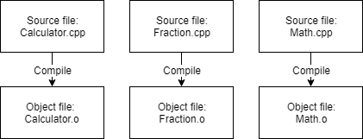
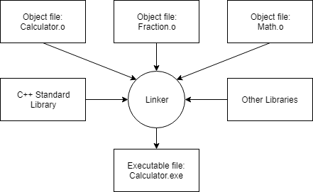

Slide 8
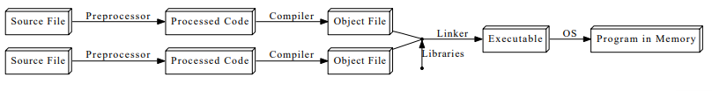
C++ Program Phases Diagram

Slide 9
Our first program
// hello.cpp
// A First Program in C++
#include <iostream>
int main()
{
std::cout << "Hello World!\n";
return 0;//indicates that the program ended successfully
}

Slide 10
Line-by-line Explanation
// indicates that everything following it until the end of the line is a comment: it is ignored by the compiler.
Another way to write a comment is to put it between /* and */ (e.g. x = 1 + /*sneaky comment here*/ 1;).
A comment of this form may span multiple lines. Comments exist to explain non-obvious things going on in the code. Use them: document your code well!
Lines beginning with # are preprocessor commands, which usually change what code is actually being compiled. #include tells the preprocessor to dump in the contents of another file, here the iostream file, which defines the procedures for input/output.

Slide 11
Line-by-line Explanation
int main() {...} defines the code that should execute when the program starts up. The curly braces represent grouping of multiple commands into a block. More about this syntax in the next few lectures.
cout << : This is the syntax for outputting some piece of text to the screen.
<< stream insertion operator: Expression to the right of the operator is inserted (sent) to the cout object (the display screen or console window).
Instead of cout << "Hello World!\n";
you can use cout << “Hello World!" << endl;

Slide 12
Line-by-line Explanation
Namespaces: In C++, identifiers can be defined within a context – sort of a directory of names – called a namespace.
When we want to access an identifier defined in a namespace, we tell the compiler to look for it in that namespace using the scope resolution operator (::).
Here, we’re telling the compiler to look for cout in the std namespace, in which many standard C++ identifiers are defined.
A cleaner alternative is:
#include <iostream>
using namespace std;
int main()
{
cout << "Hello World!\n";
return 0;
}

Slide 13
Line-by-line Explanation
Strings: A sequence of characters such as Hello, world is known as a string. A string that is specified explicitly in a program is a string literal.
Escape sequences: The \n indicates a newline character. It is an example of an escape sequence – a symbol used to represent a special character in a text literal.
return 0 indicates that the program should tell the operating system it has completed successfully. This syntax will be explained in the context of functions; for now, just include it as the last line in the main block.
Note that every statement ends with a semicolon (except preprocessor commands and blocks using {}). Forgetting these semicolons is a common mistake among new C++ programmers.

Slide 14
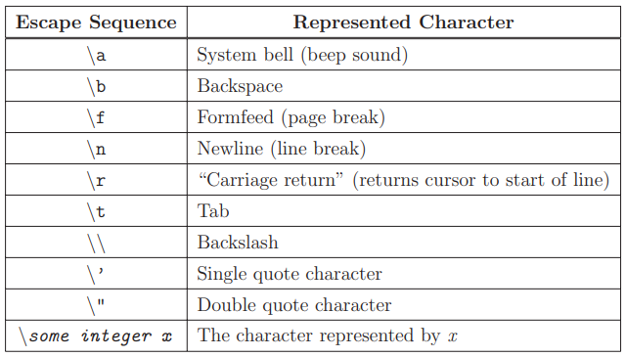
Escape Sequences

Slide 15
A simple C++ program
The best approach in learning programming for the first time is to treat it like a game. And, as anyone knows, when you learn a game don't try to understand it just yet – simply learn the "rules of the game" at first. When you have a few simple programs under your belt, you will be able to understand a bit about why the code is the way it is.
This program here produces the output on the next slide
//mean1.cpp
// This program calculates the mean of three numbers.
#include <iostream>
using namespace std; //need this to drop std::
int main()
{
cout << "First Arithmetic Program by Big Bird.\n\n";
cout << (12+5+10)/3;
return 0;
} //end main

Slide 16
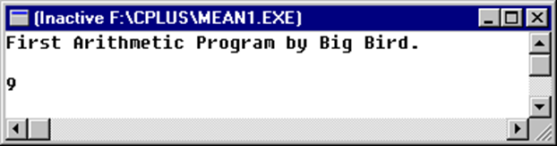
A simple C++ program
This program here produces the output below.
//mean1.cpp
// This program calculates the mean of three numbers.
#include <iostream>
using namespace std; //need this to drop std::
int main()
{
cout << "First Arithmetic Program by Big Bird.\n\n";
cout << (12+5+10)/3;
return 0;
} //end main

Slide 17

More on cout & cin
You can print as many items as you wish to cout, by chaining the items with the << operator. For example,
cout << "hello" << " world, " << "again!" << endl;
cout << "hello," << endl << "one more time. " << endl << 5 << 4 << 3 << " " << 2.2 << " " << 1.1 << endl;

Slide 18
More on cout & cin
<iostream>
using namespace std;
int main() {
int firstInt; // Declare a variable named firstInt of the type int (integer)
int secondInt; // Declare a variable named secondInt of the type int
int sum, difference, product, quotient;
// Declare 4 variables of the type int to keep the results
cout << "Enter first integer: "; // Display a prompting message
cin >> firstInt; // Read input from keyboard into firstInt
cout << "Enter second integer: "; // Display a prompting message
cin >> secondInt; // Read input into secondInt

Slide 19
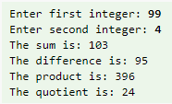
More on cout & cin
// Perform arithmetic operations
sum = firstInt + secondInt;
difference = firstInt - secondInt;
product = firstInt * secondInt;
quotient = firstInt / secondInt;
// Print the results
cout << "The sum is: " << sum << endl;
cout << "The difference is: " << difference << endl;
cout << "The product is: " << product << endl;
cout << "The quotient is: " << quotient << endl;
return 0;
}

Slide 20

Reading multiple items in one cin statement
We could read more than one values in one cin statement. For example,
// Put out a prompting message
cout << "Enter two integers (separated by space): "; ;
// Read two values into respective variables
cin >> firstInt >> secondInt
sum = firstInt + secondInt;
cout << "The sum is: " << sum << endl;

Slide 21
Review
What did we learn in this lecture? Plenty.
arithmetic operator
assignment operator
comment
compiler
function header
ide
link, load, execute
logical operator
main function
object program
preprocessor
relational operator
return statement
source program
stream insertion operator

Slide 22
Basic Language Features

Slide 23
Values and Statements
A statement is a unit of code that does something – a basic building block of a program.
An expression is a statement that has a value – for instance, a number, a string, the sum of two numbers, etc. 4 + 2, x - 1, and "Hello, world!\n" are all expressions

Slide 24
Operators
Mathematical: +, -, *, /, and parentheses have their usual mathematical meanings, including using - for negation. % (the modulus operator) takes the remainder of two numbers: 6 % 5 evaluates to 1.
Logical: used for “and,” “or,” and so on. More on those in the next lecture.
Bitwise: used to manipulate the binary representations of numbers. We will not focus on these.

Slide 25
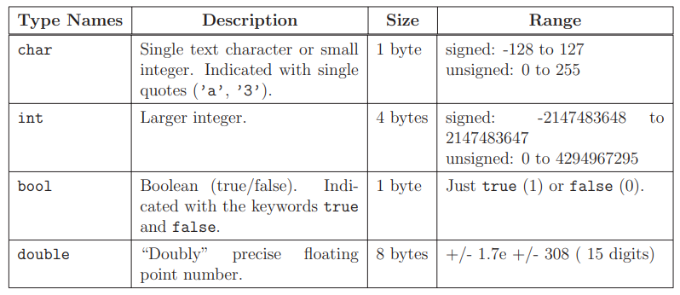
Data Types
There are actually 3 integer types: short, int, and long
The same goes for the 3 floating point types, float, double, and long double
The sizes/ranges for each type are not fully standardized; those shown above are the ones used on most 32-bit computers.

Slide 26
Data Types
An operation can only be performed on compatible types. You can add 34 and 3, but you can’t take the remainder of an integer and a floating-point number.
An operator also normally produces a value of the same type as its operands; thus, 1 / 4 evaluates to 0 because with two integer operands, / truncates the result to an integer. To get 0.25, you’d need to write something like 1 / 4.0.
A text string, for reasons we will elaborate later, has the type char *

Slide 27
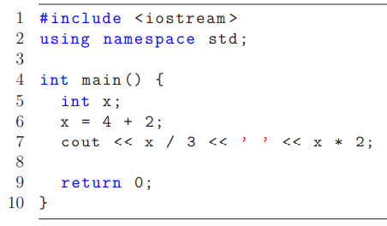
Variables
Line 5 is the declaration of the variable x. We must tell the compiler what type x will be
so that it knows how much memory to reserve for it and what kinds of operations may be
performed on it.
Line 6 is the initialization of x, where we specify an initial value for it. This introduces a
new operator: =, the assignment operator. We can also change the value of x later on in the
code using this operator.
We could replace lines 5 and 6 with a single statement that does both declaration and
initialization:
int x = 4 + 2;

Slide 28
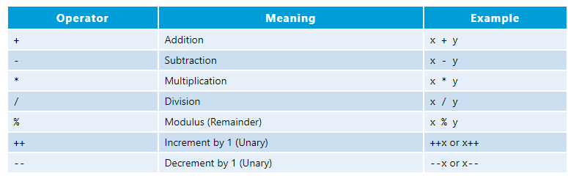
Basic Arithmetic Operations
Addition, subtraction, multiplication, division and remainder are binary operators that take two operands (e.g., x + y);
while negation (e.g., -x), increment and decrement (e.g., x++, --x) are unary operators that take only one operand.

Slide 29
Flow of Control

Slide 30
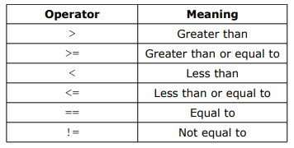
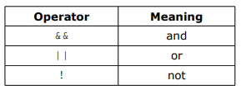
Operators
Unary operator
Examples using logical operators (assume x = 6 and y = 2):
!(x > 2) → false
(x > y) && (y > 0) → true
(x < y) && (y > 0) → false
(x < y) || (y > 0) → true

Slide 31
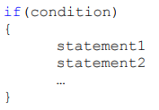

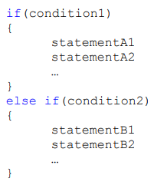
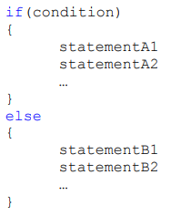
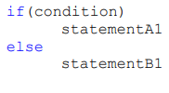
Conditionals (if, if-else and else if )

Slide 32
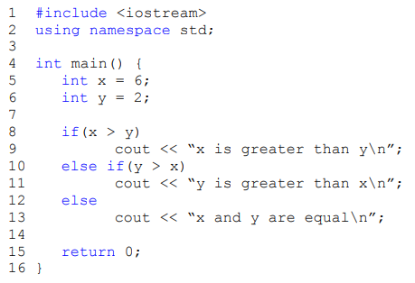
Conditionals (if, if-else and else if )

Slide 33
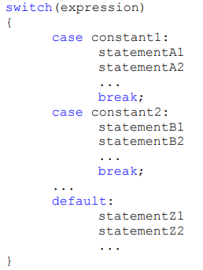
Conditionals (switch-case)

Slide 34
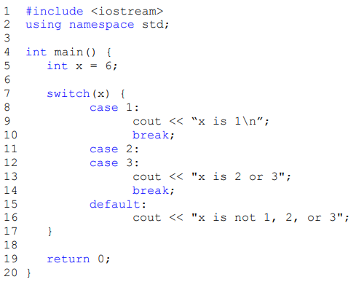
Conditionals (switch-case)

Slide 35
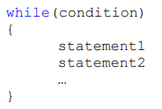
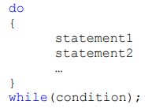
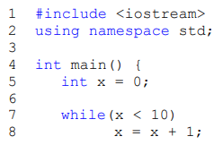
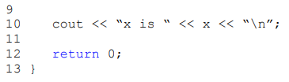
Loops (while and do-while)

Slide 36
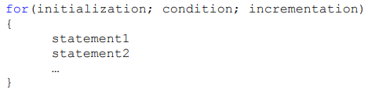
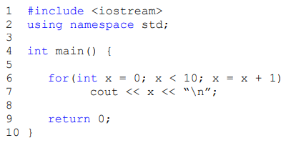
Loops (for)

Slide 37
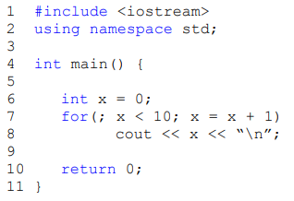
Loops (for)

Slide 38
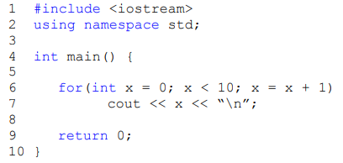
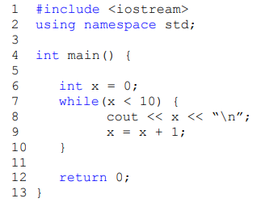
Loops
A for loop can be expressed as a while loop and vice-versa.

Slide 39
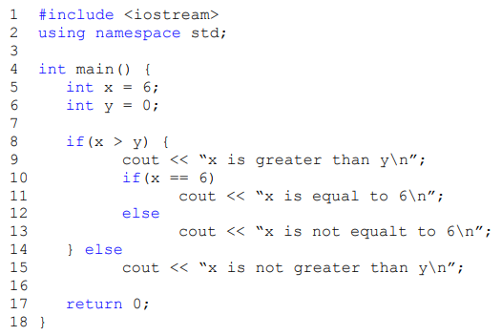
Nested Control Structures

Slide 40
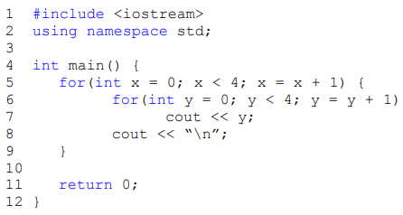
Nested Control Structures

Slide 41
References
http://cpp.proffriedman.net/home/lecture-notes
https://ocw.mit.edu/courses/electrical-engineering-and-computer-science/6-096-introduction-to-c-january-iap-2011/lecture-notes/MIT6_096IAP11_lec01.pdf
https://www.ntu.edu.sg/home/ehchua/programming/cpp/cp0_Introduction.html

